Slide 1
Perianal suppuration- Abscess & Fistula
Dr Pankaj Kumar
Assistant Professor
Surgical Gastroenterology

Slide 2
Anorectal suppurative disease may manifest as
An acute or Anal sepsis (abscess)
Anal fistula represents the chronic form of the suppurative process
A fistula and abscess may coexist
May be associated with atypical internal openings and multiple tracts that result in a complex suppurative process.

Slide 3
Anatomy
Rectum- hind gut 6 weeks
Anal canal- 8 week – ectoderm.
Dentate line transition from endoderm to ectoderm.
Anal canal- 4cm, pelvic diaphragm to anal verge.
4-8 anal glands drains by crypts at dentate line

Slide 4
External sphincter: striated muscle.
voluntary control
Internal sphincter: smooth muscle
Autonomic control
contracted at rest

Slide 5
Etiology
Nonspecific :
Cryptoglandular in origin.
Specific :
Crohn’s
Ulcerative colitis
TB
Actinomycosis
Carcinoma
Trauma
Radiation
Foreign body
Lymphoma
Pelvic inflammation
Leukemia

Slide 6
Pathophysiology
glandular secretion
stasis infection &
suppuration
anal crypt obstruction
abscess formation

Slide 7
Anorectal abscess

Slide 8
Classification
Perianal – 60%
Ischiorectal- 20%
Intersphincteric- 12%
Supralevator- 5%
Submucosal – 1%

Slide 9
DIAGNOSIS
History
gradual onset of pain
sensation of pressure and fullness
fever
previous episode of anorectal sepsis

Slide 10
Physical Examination
Localized swelling,
Hyperemia,
Induration
Tenderness
DRE &/or PV examination
Examination in GA
Can be confirmed by needle aspiration.

Slide 11
TREATMENT
should be considered a surgical emergency
Incision and drainage.
Antibiotics as adjunctive therapy –
valvular heart disease
immunosuppression
extensive associated cellulitis
diabetes

Slide 12
Perianal Abscess :cruciate incision at tender or fluctuant point as close to the anal verge.
Ischiorectal Abscess
Intersphincteric Abscess : internal sphincterotomy overlying the cavity.
Submucosal Abscess : incising the mucosa over the abscess.

Slide 13
Postanal Abscess and Horseshoe Extension
Hanley's technique -the posterior midline incision
muscles attached to the coccyx, the superficial external sphincter, and the lower edge of the internal sphincter are divided
one or multiple secondary incisions in the skin overlying the ischiorectal space.

Slide 14
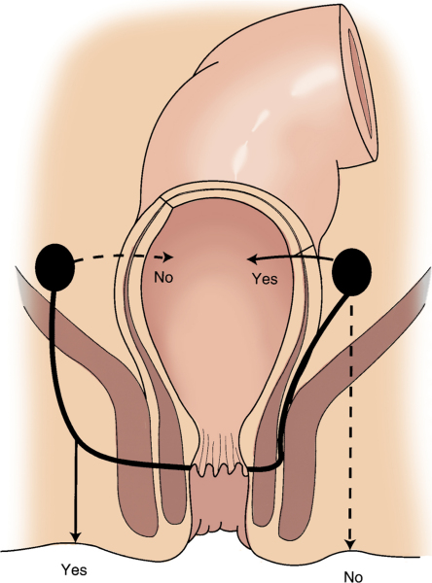
Appropriate type of drainage of supralevator abscesses depending on the course taken by the fistula tract.

Slide 15
Fistula in ano
a communication between an internal opening in the anal canal and an external opening through which an abscess drained

Slide 17
Intersphincteric
Trans-sphincteric
Suprasphincteric
Extrasphincteric
Miscellaneous or nonclassified
- 50
- 28
- 7
- 2
- 13

Slide 18
History
previous history of anorectal suppuration
intermittent or persistent purulent or serosanguineous drainage from an external opening in the perianal area.
Pruritic symptoms may be present

Slide 19
Examination
Perianal examination
DRE
Anoscopy

Slide 20
Evaluation of Anal Fistula
An accurate preoperative assessment of the anatomy of an anal fistula is very important.
Five essential points of a clinical examination of an anal fistula :
(1) location of the internal opening.
(2) location of the external opening.
(3) location of the primary track .
(4) location of any secondary track.
(5) determination of the presence or absence of underlying disease .

Slide 21
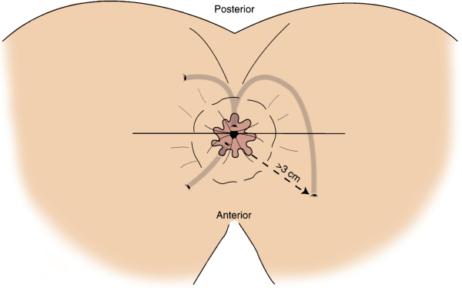
Goodsall’s rule

Slide 22
Special Studies
Sigmoidoscopy and Colonoscopy
all patients with anorectal fistulas
presence of associated pathology such as
neoplasms,
inflammatory bowel disease,
associated secondary tracts

Slide 23
Fistulography
with recurrent fistulas or
when a prior procedure has failed to identify the internal opening
useful in identifying unsuspected pathology, planning surgical management, and demonstrating anatomic relations.

Slide 24
Anorectal Ultrasonography
For anatomy of the anal sphincters in relation to an abscess or a fistula.
7- or 10-MHz transducer
Fistula tracts and abscesses appear as hypoechoic defects within the muscle.
extrasphincteric, and suprasphincteric tracts may be missed.
hydrogen peroxide injected into fistulas is safe, effective, and more accurate than conventional transanal ultrasound

Slide 25
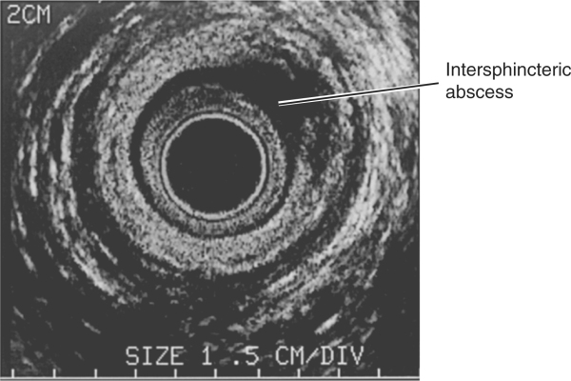

Slide 26
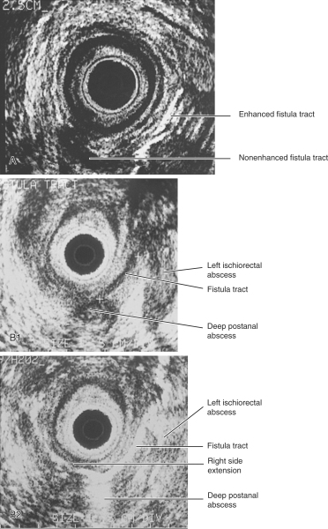
Notes:
A, Trans-sphincteric hypoechogenic tract extending toward the posterior midline. The tract is enhanced as hydrogen peroxide is injected into the external opening. B, Complex fistula tract and collections as seen without (1) and with (2) hydrogen peroxide enhancement. Hydrogen peroxide enhancement allowed for a more precise delineation of the tracts in addition to a right-sided extension of the tract

Slide 27
Magnetic Resonance Imaging
for anatomy
chronic or recurrent fistula
saline solution as a contrast agent
gadolinium enema: enhanced T2 images and improved lesion identification
Computed Tomography:
Limited due to poor visualization of the levators and sphincter complex.
For assessment of associated pelvic pathology

Slide 28
Anorectal Manometry
assist in identifying patients at the risk for postoperative incontinence.
Surgical management can be tailored accordingly, improving clinical and functional outcome.
Indications:
suspected sphincter impairment;
needing substantial portions of the external sphincter divided for fistula cure;
women with a history of multiparity, forceps delivery, third-degree perineal tear, high birthweight, or prolonged second stage of labor.

Slide 29
Fistuloscopy
intraoperative technique to identify primary fistula openings, multiple or complex tracts, and iatrogenic tracts

Slide 30
TREATMENT
should undergo surgical treatment, rarely heal spontaneously.
prone jackknife position
General, regional, or local anesthesia
The three basic surgical techniques are
fistulotomy,
use of a seton,
endorectal advancement flaps

Slide 31
Fistulotomy
Most fistulas may be adequately treated.
Recurrence rates are low,
Risks for continence disturbances are minimal
cautery is used to lay it open.
Secondary tracts should be drained through the fistulotomy incision

Slide 32
Seton Management
Foreign material that is inserted into the fistula tract to encircle the sphincter muscles.
Indications
Complex anorectal fistulas with risk of incontinence.
Poor healing:
Crohn's disease,
immunocompromised
incontinent patients,
patients with chronic diarrheal states,
anterior fistulas in women

Slide 33
Setons may be used as
marking,
draining,
cutting,
staging

Slide 34
Anorectal Advancement Flaps
Advancement flaps consist of mucosa, submucosa, and part of the internal sphincter
Advantages
one-stage procedure,
quicker healing,
limited damage to the underlying sphincter,
minimal risk of anal canal deformity

Slide 35
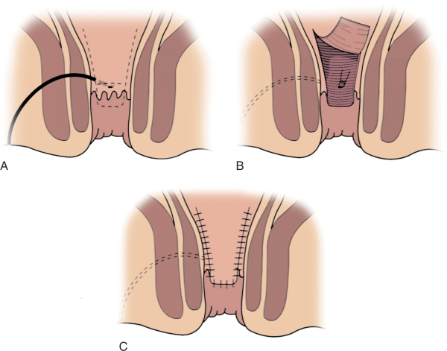

Slide 36
Fibrin Glue
mixture of fibrinogen and thrombin is injected into the fistula tract .
POSTOPERATIVE CARE
Sitz baths -for perianal hygiene and comfort.
pain management and
wound care

Slide 37
COMPLICATIONS
Urinary retention -most common 25%
hemorrhage,
acute external thrombosed hemorrhoids,
cellulitis,
fecal impaction,
stricture,
rectovaginal fistula,
incontinence
recurrence. (3% to 7%).

Slide 38
Sepsis and Fistula in Human Immunodeficiency Virus Disease
Incidence -6% to 34%.
wound healing increases as the preoperative CD4⁺ count increases.
In the absence of risk factors -fistulotomy for simple fistulas
For complex fistulas and patients with risk factors for poor healing -draining setons for symptomatic relief.

Slide 39
Crohn's Disease
incidence of perianal complications-22 -54%
Anorectal abscess - drainage.
A simple fistula in a patient with a normal rectum -primary fistulotomy .
Complex fistulas in patients with active rectal Crohn's disease remain a therapeutic challenge. These cases are better served with prolonged drainage

Slide 40
treatment modalities should be conservative.
Extensive procedures may increase the risk of incontinence and nonhealing wounds.
long-term administration of metronidazole
with symptomatic improvement 71% to 100%
Infliximab -monoclonal antibody to tumor necrosis factor (TNF)-α

Slide 41
Thanks

Slide 42
MCQ -1
Most common etiology of perianal suppuration is-
A. Crohn’s disease
B. Non specific (cryptoglandular)
C. Pelvic inflamation
D. leukemia

Slide 43
2
Least common abscess is-
A. Perianal
B. Ischiorectal
C. Intersphincteric
D. Supralevator
E. Submucosal

Slide 44
3
Most common fistula is-
A. Intersphincteric
B. Trans-sphincteric
C. Suprasphincteric
D. Extrasphincteric

Slide 45
4
Goodsall’s rule :all are ture except
A. All posterior external opening have curved tract.
B. All anterior external opening have straight tract.
C. All posterior internal opening have curved tract.
D all anterior internal opening have straight tract.

Slide 46
5
Treatment for complex fistula in crohns are all except-
A. Draining seton
B. Fistulotomy
C. metronidazole
D. infliximab

Slide 47
6
In HIV all are true except-
A. Incidence -6% to 34%.
B. wound healing increases as the preoperative CD4⁺ count decreases.
C. In the absence of risk factors -fistulotomy for simple fistula
D. For complex fistulas and patients with risk factors for poor healing -draining setons for symptomatic relief.

